Slide 1
Lesson 3 FPGA Programming Basics
Introduction
Defining FPGA Logic with LabVIEW
Developing the FPGA VI
Interactive Front Panel Communication
Selecting an Execution Mode
Compiling the FPGA VI
Basic Optimizations
Notes:
Lesson objectives:
Understand at a high level how logic is implemented on an FPGA.
Understand at a high level how LabVIEW code is translated and compiled into FPGA hardware.
Create an FPGA VI.
Recognize VI and palette differences under FPGA target vs. My Computer
Understand the relationship of interactive front panel communication with FPGA target
Execute a VI on the development computer and understand why it is beneficial to test on development computer before compiling/deploying.
Compile and run an FPGA VI.
Understand the compile report and know how to proceed if it fails.

Slide 2
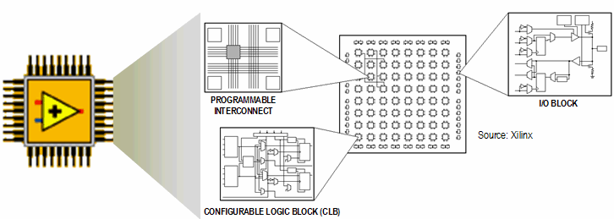
A. Introduction
FPGA Layout and Components
Notes:
A. Introduction
An FPGA is a chip that can be reconfigured through software for different applications. The LabVIEW FPGA Module targets the following NI reconfigurable I/O (RIO) devices:
R Series data acquisition (DAQ)
CompactRIO
Compact Vision
IF-RIO
Refer to ni.com for a current list of devices. R Series DAQ devices support complex data acquisition or real-time I/O applications. FPGA logic on an NI Compact Vision system adds custom triggering, pulse width modulation (PWM) signals, motion control, or custom communications protocols. CompactRIO uses FPGA for modularity, FPGA-timed I/O with built-in signal conditioning, and direct signal connectivity for maximum flexibility in embedded measurement and control applications.

Slide 3
How an FPGA Works
Programmable interconnect switches and wires route signals between various hardware resources in an FPGA
Hardware resources include logical gates, flip-flops, and block memories
For a more detailed description of how FPGA works, see http://www.ni.com/fpga_technology/.
Notes:
For a more detailed description of how FPGA works, see http://www.ni.com/fpga_technology/.
Specifically, it will be helpful to review FPGAs - Under the Hood.

Slide 4
How FPGA Works - Example
Implements a VI that calculates a value for F from inputs A, B, C, and D, where F = (A + B) x C x D
Notes:
An FPGA is analogous to a printed circuit board that has a large number of unconnected components. Traditionally, the devices are connected with physical wires soldered to the pins with a wire wrapping tool, or embedded in the printed circuit board. The physical wires are difficult to modify. However, the connections in an FPGA circuit are dynamically defined in software when the LabVIEW code compiles and the bitstream is downloaded. The bitstream causes semiconductor switches to turn on or off, thereby defining the connections between gates.

Slide 5
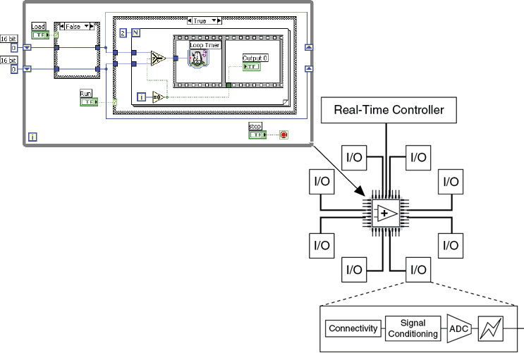
B. Defining FPGA Logic with LabVIEW
LabVIEW FPGA
Do not have to learn VHDL or Verilog
True parallel execution
Deterministic

Slide 6
True Parallel Execution
F = (A+B)C and Z = X+Y+M in separate gates on an FPGA

Slide 7
I/O, FPGA, and Host Communication
FPGA provides:
Timing
Triggering
Processing
Custom I/O
Each fixed I/O uses a portion of the FPGA hardware resources
The computer interface also uses a portion of the FPGA hardware resources

Slide 8
Timing Features of FPGA
Multi-loop analog PID loop rates exceed 100 kHz on embedded RIO FPGA hardware whereas they run at 30 kHz in real-time without FPGA hardware
Digital control loop rates can execute up to 1 MS/s or more depending on the target
Single-cycle timed loops execute up to 200 MHz or more depending on the target and clock configuration
Due to parallel processing ability, adding additional computation does not necessarily reduce the speed of the FPGA application

Slide 9
C. Developing the FPGA VI
There is no operating system on the FPGA
Download and run only one top-level VI at a time
FPGA can run independently of the host
FPGA can store data in memory
Edit VI under an FPGA Target to use the FPGA palette
Use integer or fixed-point math to perform calculations
Notes:
Instructor Note: Refer students to www.ni.com/ipnet for FPGA examples and intellectual property that other customers have developed and chosen to share. This site contains a number of module-specific examples as well as complete applications.
If you have an internet connection, navigate to this website and show the students around the site.
Also, there are shipping-examples available from the NI Example Finder.

Slide 10
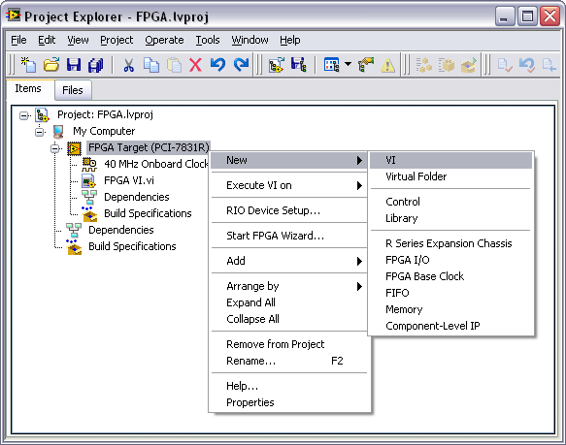
Add a VI Under the FPGA Target
Notes:
You start building the FPGA VI from the Project Explorer. Right-click the FPGA target and select New»VI as shown in the figure above. Save the VI in an appropriate folder and save the project.

Slide 11
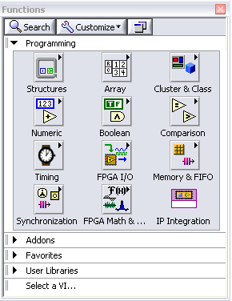
FPGA Palettes
VIs under the FPGA target inherit the FPGA Function Palette
Many palettes are similar to LabVIEW for Windows
FPGA-specific palettes
FPGA I/O
Memory & FIFO
Synchronization
FPGA Math & Analysis
IP Integration
Notes:
FPGA I/O, Memory & FIFO, Synchronization, FPGA Math & Analysis and IP Integration palettes are specific to the FPGA module and are only available when editing VIs under an FPGA target.

Slide 12
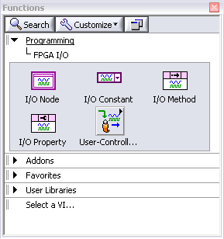
FPGA I/O Palette
Notes:
Provide communication with I/O modules

Slide 13
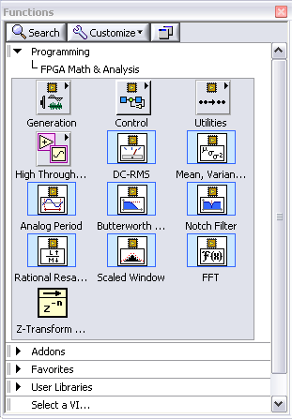
FPGA Math & Analysis Palette
Keep calculations as simple as possible to preserve space on the FPGA
Functions perform point-by point calculations
Notes:
LabVIEW 8.2 and prior
Only integer math
LabVIEW 8.5 and later
Allows for integer math and fixed-point calculations

Slide 14
Demonstration 3-1
Create an FPGA VI and explore the Functions palette supported under FPGA.
Notes:
Open the solution to Exercise 2-4, CompactRIO.lvproj
Create a new VI on the FPGA target.
Explore the function and control palettes.
Be sure to navigate to the FPGA I/O and FPGA Math and Analysis palettes

Slide 15
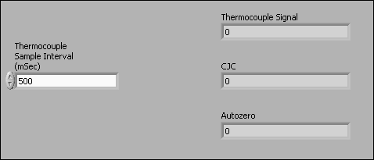
Top-Level FPGA VI Front Panel
Hardware resources inside an FPGA are limited
Use the minimum necessary controls and indicators for programmatic Front-panel communication to a host
Add temporary controls and indicators for debugging if necessary, but remove them
Notes:
“Simple controls and indicators” include numerics, Booleans, strings, etc. That is, any non-array/cluster control or indicator.

Slide 16
D. Interactive Front Panel Communication
FPGA has no user interface
Must communicate data from FPGA to Host PC or rely exclusively on I/O
Front Panel displayed on Host PC
Block Diagram executes on FPGA as compiled
Communication layer shares all control and indicator values
Cannot use debugging tools when running FPGA VI
Test with development computer first, or add indicators as probes

Slide 17
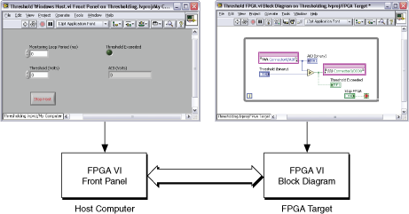
Interactive Front Panel Communication
Notes:
You use Interactive Front Panel Communication to communicate between the host computer and the VI running on the FPGA as shown in the figure above. You use Programmatic FPGA Interface Communication to programmatically control and communicate with FPGA VIs from host computer VIs. The front panel data you receive during Interactive Front Panel Communication is not deterministic.
You will learn alternate communication processes later in this course.

Slide 18
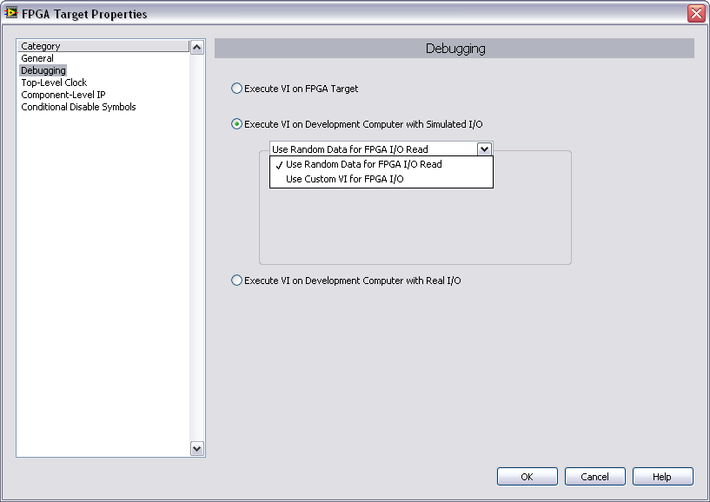
E. Selecting an Execution Mode
Right-click the FPGA Target in the Project Explorer window and select Properties to launch FPGA Target Properties dialog box
Or
Right-click the FPGA Target and select Execute VI on to select mode directly

Slide 19
Selecting an Execution Mode – Options
Execute VI on FPGA Target
Execute VI on Development Computer with Simulated I/O
Use Random Data for FPGA I/O Read
Use Custom VI for FPGA I/O
Execute VI on Development Computer with Real I/O
Not supported by all FPGA targets
Notes:
Execute VI on FPGA Target – The FPGA VI will execute on the FPGA target. Before running on the FPGA, the code must be compiled.
Execute VI on Development Computer with Simulated I/O – The FPGA VI will execute on the development computer using simulated data for any I/O. You can either use random data for I/O reads or you can create and use a custom VI to generate your simulated I/O.
Execute VI on Development Computer with Real I/O – This method executes the VI on the development computer but uses real I/O data from the FPGA target. This method is not supported by all FPGA targets and some of the targets that do support it do not support all I/O resources.

Slide 20
Testing with the Development Computer
Compiling to run on the FPGA can require a few minutes to several hours
Verify logic before compiling by executing the VI on the development computer (Windows PC)
Traditional debugging tools are available
Notes:
You can run the FPGA VI in Windows to check the logic of the application before compiling. The development computer simulates the I/O operations but does not duplicate the hardware timing. The development computer can use either simulated I/O or real I/O from the FPGA target. Simulated I/O can be generated using random data or a custom VI.
Troubleshoot using traditional debugging tools:
Execution highlighting – Execution highlighting shows the movement of data on the block diagram from one node to another using bubbles that move along the wires.
Single-stepping – Single-step through a VI to view each action taken by each VI on the block diagram as the VI runs.
Probe tools – Use the Probe tool to check intermediate values on a wire as the VI runs.
Breakpoints – Use the Breakpoint Tool to place a breakpoint on a VI, node, or wire and pause execution at that location.
When testing is complete, set the execution mode to the FPGA target so that the VI can be compiled and tested on the FPGA target.

Slide 21
Exercise 3-1: VI Execution on the Development Computer
Create an FPGA VI and verify the functionality of the VI using the development computer.
Notes:
Prep discussion:
In this exercise, students will open and modify the project that they worked on in Exercise 2-4.
They will develop a VI to perform basic arithmetic and test it on the development computer.
Encourage the students to explore the different palettes that are available on the FPGA target.

Slide 22
Exercise 3-1: VI Execution on the Development Computer
Note how quickly you were able to progress from development to testing.
Have you ever tried troubleshooting a VI without using the debugging tools?
Notes:
The debugging tools are only available when executing on the development computer. When you compile code to execute on the FPGA target, those tools will no longer be available.

Slide 23
F. Compiling the FPGA VI
Turn the FPGA VI into executable code
FPGA Module compiles VI
Graphical code translated to VHDL
Xilinx ISE compiler creates circuit from VHDL
Compiler optimizes the implementation
A bitstream file results
Bitstream loads at run-time
Windows OS
LabVIEW
FPGA VI
(1) Intermediate Files
Compile
Server
Compile
Worker
(1) Intermediate Files
Bit File Embedded
(2) Bit File
Notes:
Bitstream may reload at power-up if target is configured for that
On-board flash memory
Controller over PCI Bus

Slide 24
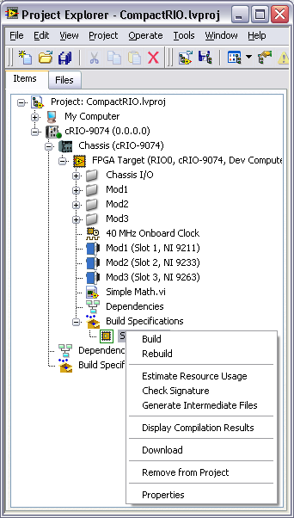
Working with Build Specifications
You must create a build specification before you can compile an FPGA VI
If you do not create one, LabVIEW creates and specifies a default specification for the VI
You can specify a default build specification
To create a build specification, right-click a build specification under an FPGA target in the Project Explorer window.
Available options vary by target
Notes:
You must create a build specification before you can compile the FPGA VI into an FPGA application. If you click the Run button without first making a build specification, LabVIEW automatically creates and specifies a default build specification for the corresponding VI. LabVIEW uses the build options you set to generate the HDL and bitfile from the block diagram.
Right-click a build specification under an FPGA target in the Project Explorer window and select from the following options. The options can vary depending on the hardware target.

Slide 25
Common Build Specification Actions
Build—This command compiles the VI.
Estimate Resource Usage—Estimates FPGA resource usages without compiling.
Generate Intermediate Files—Generates intermediate files without compiling the VI. Useful for catching certain code generations errors.
Display Compilation Results—Displays the Compilation Status window. You must build the build specification once to display the Compilation Status window.

Slide 26
Stages of the Compilation Process
Generation of Intermediate Files (HDL code)
Estimation of resource usage
HDL Compilation, Analysis and Synthesis
Mapping
Placing and Routing
Generating Bitstream
Notes:
Generate Intermediate Files – LabVIEW converts the VI into intermediate files to send to the LabVIEW FPGA Compile Server.
Estimation of resource usage– Estimate FPGA resource usages without compiling. If the generated code signature is not current, this command first generates intermediate files and then estimates resource usage.
HDL compilation, analysis, and synthesis—Transforms intermediate files into digital logic elements.
Mapping—Divides the application logic between the physical building block on the FPGA.
Placing and Routing—Assigns the logic to physical building blocks on the FPGA and routes the connections between the logic blocks to meet the space or timing constraints of the compilation.
Generating Bitstream—Creates binary data that LabVIEW saves inside a bitfile.

Slide 27
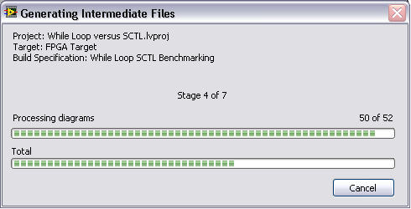
Generate Intermediate Files (HDL Code)
Click Run
Generating Intermediate Files window launches
Converts graphical code to VHDL
Generates intermediate files
Once compilation starts, do not edit the VI
Create a compilation queue by starting another compilation while the first is still running
Notes:
Do not edit VI while compiling. Either abort the compilation or save the modified VI under a different filename and perform your edits there.
You can create a queue of compilations by opening another FPGA VI and starting a compile for that VI while the first compilation is still running. Once the first compilation finishes, the next will start.

Slide 28
Exercise 3-2, Part A: VI Execution on the FPGA Target
Begin Exercise 3-2 to start compilation of a working VI to run on an FPGA target.
Do only Part A.
Notes:
Prep discussion:
Open existing project and modify to execute on FPGA target
Part A ends with initiating the compilation.
While the code compiles, lecture will resume. Ask students to indicate when they have started compiling so that you can resume lecture as soon as possible.
During lecture, students can open the dialogs that are being discussed.

Slide 29
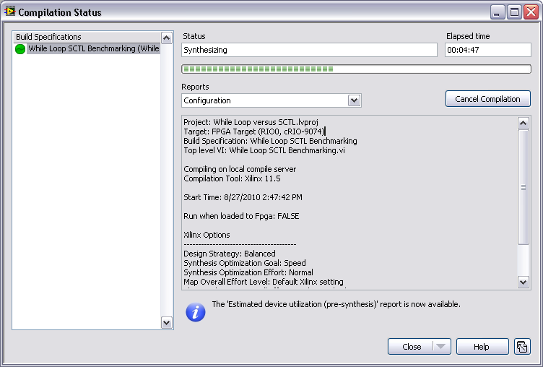
Compilation Status Window
Reports
Select the report that is displayed
Close Option
Close window
Disconnect All
Cancel All Compilations
Help
Notes:
The Compilation Status window appears when you compile an FPGA VI. If you have compiled a build specification already, you can right-click the build specification and select Display Compilation Results from the shortcut menu to display this window.
Use this window to view status and compilation information for the FPGA build specification. You also can use this window to disconnect from the compile server or cancel the compilation.
This window includes the following components:
Build Specifications—Lists the build specifications that are compiling or have compiled during this session of the Compilation Status window. To remove a build specification from this list, right-click the build specification and select Remove from List from the shortcut menu.
Status—Displays the progress of the FPGA VI compilation.
Last Update Time—Displays the last time the compile server updated the information.
Reports—Specifies the type of compiler information you want to view. Not all reports are available at the beginning of the compilation. A message appears in the Compilation Status window when reports become available to view.
Save—Saves the final compilation status report to a file. The Save button is available only for the Xilinx log report and only when the compilation is complete.
Investigate Timing Violation—Displays the Timing Violation Analysis window. This button is available only if a timing violation occurs.
Cancel Compilation—Cancels the compilation of the build specification you select in the Build Specifications list.
Close—Closes the Compilation Status window. Use the pull-down menu on this button to close the window with the following options.
Close Window (default)—Closes the window and continues communicating with the compile server.
Disconnect All—Disconnects LabVIEW from the compile server. Any compilation jobs running will continue, but LabVIEW will not receive any updates. Disconnect from the compile server when you want to shutdown LabVIEW. You do not need to disconnect from the compile server to perform other operations in LabVIEW while the FPGA VI is compiling.
Cancels All Compilations—Cancels the current compilation jobs.

Slide 30
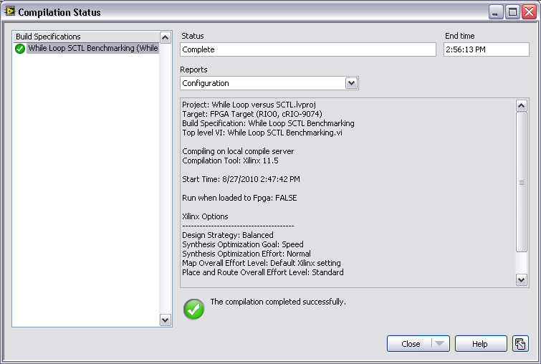
Configuration Report
Project information
Xilinx compiler configuration for the FPGA VI

Slide 31
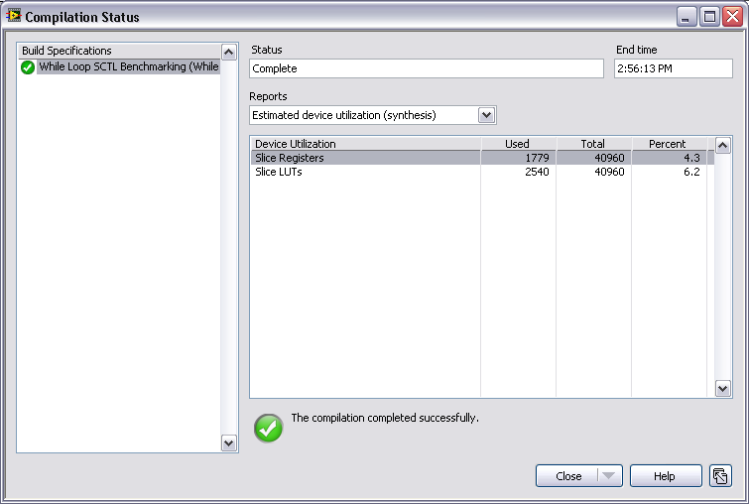
Device Utilization Report
Separate reports generated at pre-synthesis and synthesis stages of compilation
Notes:
Device Utilization Report Details
There are two Device Utilization reports generated. The first is available after the compilation server completes the synthesis step of compilation. The other is available after the mapping step.
This report contains a summary of the FPGA utilization, including the following information:
Device Utilization—Indicates the FPGA element, such as slices, flip-flops, LUTs, and blocks of RAM
Used—Indicates how much of the FPGA element the compiled FPGA VI uses.
Total—Indicates how much of the FPGA element is available.
Percent—Indicates the percentage of used FPGA element to total FPGA element.
If the Percent column approaches or exceeds 100%, you may want to stop the compilation and optimize your code. This condition is a good indicator of a potential failure in a later stage of compilation.

Slide 32
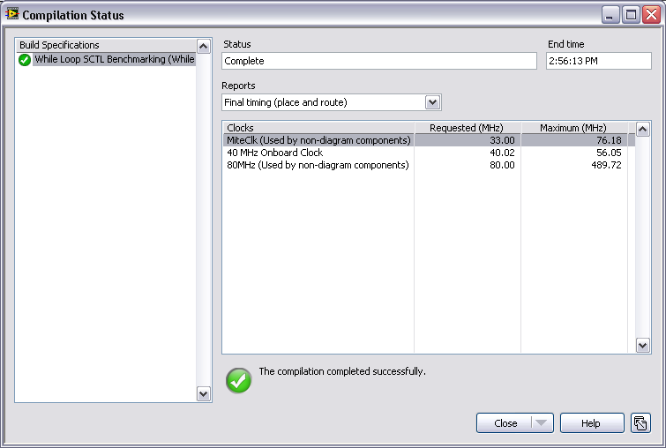
Timing Report
Separate reports generated at mapping (estimated values), and placing and routing (actual values) stages of compilation
Notes:
Timing Report Details
There are two timing reports generated over the course of compilation. The first is generated after the mapping stage and the second is generated after the placing and routing stage.
The second report is available after the compilation server completes the routing step of the compilation process. This report contains a summary of the FPGA clocks, including the following information:
Clocks—Indicates the clock rate, in megahertz, at which the compiled FPGA VI runs.
Requested (MHz)—Indicates the clock rate, in megahertz, at which the FPGA VI or FPGA VI component must be able to run.
Maximum (MHz)—Indicates the theoretical maximum compilation rate, in megahertz, for the FPGA VI or FPGA VI component.
If the requested rate approaches or exceeds the maximum rate, you may want to stop the compilation and optimize your code. If the compilation is not able to transfer your code to the FPGA in such a way that the requested rate falls under the maximum, then the compilation will fail.

Slide 33
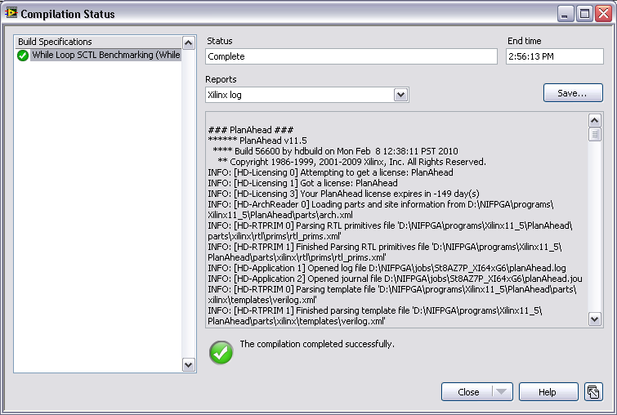
Xilinx Log Report
Includes xflow.log and xflow.twr files
Available after compilation is complete
Can be saved to a file
Notes:
Xilinx Log Report Details
This report includes the XilinxLog.txt and .twr files and is available only after the compilation is complete. The XilinxLog.txt file includes Xilinx-specific details about the compilation process. If you are familiar with Xilinx tools, you might be able to use this file to troubleshoot compilation failures. The .twr file is a trace report that provides detailed timing information. Click Save to save this information to a file.

Slide 34
Exercise 3-2, Part B: VI Execution on the FPGA Target
Complete Exercise 3-2 to view reports generated after compiling a working VI to run on an FPGA target.
Notes:
Prep discussion:
Has the compilation finished yet? Note the time indicated above the progress bar.
This is a simple VI and yet it took that long to compile. Larger, more complicated VIs will take longer.
In this exercise, the students are going to peruse several of the reports that were generated to observe the data that was logged.

Slide 35
Exercise 3-2, Part B: VI Execution on the FPGA Target
What is the benefit of having reports generated at different points of the compilation?
What if you hadn’t tested on the development computer and the VI did not function as intended?
What if your compilation fails?
Notes:
The benefit of having reports generated at different points of the compilation is that you can stop the compilation if any of your device utilization or timing parameters exceed the limits of the FPGA. That condition is an indicator of possible compilation failure.
If this were a more complicated VI and the student had compiled it without testing on the development computer, then the time spent compiling would have been wasted, because they will have to debug the application and try recompiling. They should ALWAYS test on the development computer first.
This is an open-ended question. It also leads in nicely to the next section on basic optimizations. It also ties into benchmarking (Lesson 5) and single-cycle timed loops (Lesson 7). Various other optimizations will be discussed throughout the course.

Slide 36
Compiling an FPGA VI Remotely
To free resources on the local computer, install the LabVIEW FPGA Compile Server and Compile Worker on a remote computer and compile the FPGA VI remotely
Refer to Compiling an FPGA VI Remotely (FPGA Module) in the LabVIEW Help for more information about compiling FPGA code remotely
Notes:
You can compile an FPGA VI on a computer other than the development computer. You might want to do this if the development computer is slow or does not have enough memory to compile the VI for the FPGA device. By default, LabVIEW assumes the LabVIEW FPGA Compile Server is installed on the local computer.
Also, refer students to the KnowledgeBase titled Installing and Activating LabVIEW FPGA Compile Server on a Remote Computer for more information on that topic.

Slide 37
Causes of Compilation Failure
Timing
Delays in the designed circuit exceed the period of the specified clock
Device utilization
The design requires more resources than are available on the FPGA
Notes:
FPGA VIs are limited primarily in two areas:
Speed—Relates to the actual execution speed of the FPGA gates. If the code does not execute at the loop rate you want, you must modify the application to increase the loop rate. These modifications can change the way you create and design the FPGA VI.
Size—Relates to the actual amount of space the application uses on the FPGA. If the application requires more hardware components than are physically available on the FPGA, the compile fails and the application cannot run on the FPGA.
Specific techniques for optimizing your code for each of these areas are presented later throughout this course.

Slide 38
G. Basic Optimizations
These types of optimizations are relatively easy to implement
Require no major changes in code architecture
Should be basic programming practice for all FPGA VIs
Basic Optimizations primarily affect FPGA size

Slide 39
Types of Basic Optimizations
Limit front panel objects
Use small data types
Avoid large functions

Slide 40
Limit Front Panel Objects
Each Front Panel Object on the Top-Level VI must have logic to interact with the host VI
Each read and write from the host to the FPGA is broken down into 32-bit packets to transfer across the bus
Arrays/Clusters with more than 32 bits require extra copy on the FPGA to guarantee all the data is read or written coherently
Notes:
When data is transferred across the bus between the FPGA and RT Host, it must be broken down into 32-bit packets. This limitation is due to the number of data transfer lines on the bus. Therefore if you have a front panel element that uses more than 32-bits, then that front panel element must be broken down into several 32-bit chunks and be passed along the bus piecewise. This breaking down of the data reduces overall transfer speeds and as such having larger front panel objects should be avoided.

Slide 41
Limit Front Panel Arrays
Avoid using arrays on the Front Panel
All arrays must be of fixed size
Compile fails if more bytes in array than are available
Can quickly use large amounts of FPGA size
Each bit in the array uses its own flip-flop on the FPGA
If only enough time to do 1 optimization, do this optimization
Notes:
Arrays consume significant space on the FPGA because each bit in the array uses a flip-flop on the FPGA.
When you wire an array as an input to an FPGA VI or function, the FPGA compiler creates the equivalent of a For loop to process each element of the array in sequence. If you wire a cluster as an input to an FPGA VI or function, the FPGA compiler creates parallel logic for each element of the cluster. The relationship between arrays and clusters is recursive such that if you wire a cluster of arrays as an input, the arrays are processed in parallel and the array elements are processed sequentially.
Note: Performing operations on arrays can limit the maximum top-level or derived clock rate. To maximize the FPGA clock rate, process single data points instead of arrays.

Slide 42
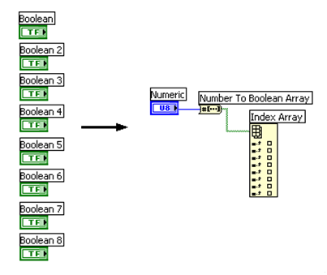
Bitpack Boolean Logic
Each control has overhead in addition to the size of the data type.
Maintain the same information using fewer controls
Display binary data as an integer
Use a Boolean array or cluster control/indicator
Notes:
Each control has enable chain overhead in addition to the size of the data type. This additional overhead requires the use of additional logic on the FPGA. By bitpacking Boolean logic, you remove this overhead.
Bitpacked logic maintains the same information using fewer controls.
Display binary data as an integer
U8 numeric control can replace eight Boolean controls
Use a Boolean array or cluster
Due to the small size of Boolean controls/indicators, this is an acceptable exception to the rule of avoiding arrays/clusters on the front panel.
You can use functions to manipulate data in the same manner as you would otherwise.

Slide 43
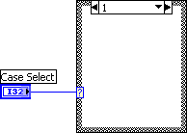
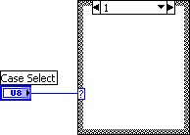
Use Small Data Types

Slide 44


Use Small Data Types - Coercion
Eliminate coercion dots
Determine necessary input format
Insert conversion function
Intentional coercion results in more efficient implementation
Notes:
Whenever a coercion dot is used it means that the complier must determine the proper data type and it can lead to inefficient conversion of data. Instead of leaving the coercion to chance it is better to directly specify the desired data type and insert the appropriate coercion function any time that you see a coercion dot on your block diagram.

Slide 45

Avoid Large Functions
Not all functions are equal
Notes:
These functions can take significant FPGA resources both in size and speed of your application.
Quotient Remainder: This function should typically be avoided if possible. If you want to divide by some power of 2, then it is best to use Scale by Power of 2 with a negative power to achieve the same results
Scale by Power of 2: This function is large when using a control for the input of the power; however, if you use a constant wired to the power, then the function is a ‘free’ function.

Slide 46
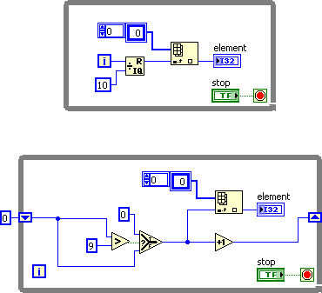
Avoid Large Functions – Quotient & Remainder
This function consumes significant space on the FPGA
Quotient & Remainder often used to increment based on iteration number
Consider replacing with actual increment function and shift register

Slide 47

Avoid Large Functions – Scale By Power of 2
Uses significant FPGA space if input for power is a control
However, if you wire a constant to the input, the function consumes no space on the FPGA
Use negative powers to replace Quotient & Remainder function whenever possible

Slide 48
Summary—Quiz
You developed a VI and set the project to execute the VI on the FPGA Target. You compile the code and run the VI. Which of the following statements is true?
The block diagram and the front panel both execute on the FPGA
The block diagram executes on the FPGA and the front panel executes on the host computer.
The block diagram executes on the host computer and the front panel executes on the FPGA.
The block diagram and front panel both execute on the host computer

Slide 49
Summary—Quiz Answer
You developed a VI and set the project to execute the VI on the FPGA Target. You compile the code and run the VI. Which of the following statements is true?
The block diagram and the front panel both execute on the FPGA
The block diagram executes on the FPGA and the front panel executes on the host computer.
The block diagram executes on the host computer and the front panel executes on the FPGA.
The block diagram and front panel both execute on the host computer
Notes:
Answer: B. The block diagram executes on the FPGA and the front panel executes on the front panel. This concept is known as interactive front panel communication. Values entered into the front panel controls are passed from the host computer to the compiled code that executes on the FPGA.

Slide 50
Summary—Quiz
Where should you first test of your FPGA VI’s functionality?
FPGA target
Development computer

Slide 51
Summary—Quiz Answer
Where should you first test of your FPGA VI’s functionality?
FPGA target
Development computer
Notes:
Answer: B. Development computer. Compilation is required before code can be executed on the FPGA target and that process can take a significant amount of time. Once the basic code functionality has been verified, then the code should be compiled and tested on the FPGA target.

Slide 52
Summary—Quiz
Which of the following is NOT the name of a report generated as part of the compilation process?
Summary
Final Device Utilization (map)
Final Timing (place and route)
Optimization

Slide 53
Summary—Quiz Answer
Which of the following is NOT the name of a report generated as part of the compilation process?
Summary
Final Device Utilization (map)
Final Timing (place and route)
Optimization
Notes:
Answer: D. Optimization. The reports that are generated can be used to determine where optimization should occur (size, timing, etc), but there is no report named Optimization.
The reports that are generated are:
Summary
Configuration
Estimated device utilization (synthesis) Estimated timing (map) Final device utilization (map)
Final timing (place and route)
Xilinx log

Slide 54
Summary—Quiz
Which of the following does NOT describe a VI that is developed under the FPGA target and set to execute on the FPGA?
The Front Panel of the FPGA VI executes on the FPGA target
Non-sequential code in an FPGA VI executes in parallel
FPGA VI executes independently of the host
Only one top-level VI can run on the FPGA at a time

Slide 55
Summary—Quiz Answer
Which of the following does NOT describe a VI that is developed under the FPGA target and set to execute on the FPGA?
The Front Panel of the FGPA VI executes on the FPGA target
Non-sequential code in the FPGA VI executes in parallel
The FPGA VI executes independently of the host
Only one top-level VI can run on the FPGA at a time.
Notes:
A. The Front Panel of the FPGA VI executes on the FPGA target. The Front Panel of the FPGA VI executes on the host computer. Only the block diagram is compiled and executed on the FPGA VI.

